Slide 1

Unit-2 Sequence and Series
Mathematics-I
GTU#(3110014)
Prof. Dhvanik H. Zala
Humanities & Science
dhvanik.zala@darshan.ac.in
8238588865

Slide 2
OUTLINE
Sequence
Increasing and Decreasing Sequence
The Sandwich Theorem OR Squeeze Theorem
Convergent, Divergent and Oscillating Sequence

Slide 3

Sequence

Slide 4
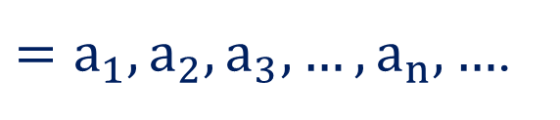





Sequence
Sequence
A sequence is a set of numbers in a specific order.
It is denoted by $\left\{a_{n}\right\}$ OR $\left(a_{n}\right)$ OR ${\left\{a_{n}\right\}}_{n=1}^{∞}$ OR ${\left\{a_{n}\right\}}_{n≥1}$.
It is written as $\left\{a_{n}\right\}$
$=a_{1}, a_{2}, a_{3},…,a_{n},…$.
$n^{th}$ term of $\left\{a_{n}\right\}$
$1^{st}$ term of $\left\{a_{n}\right\}$
$3^{rd}$ term of $\left\{a_{n}\right\}$
$2^{nd}$ term of $\left\{a_{n}\right\}$

Slide 5

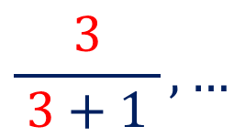
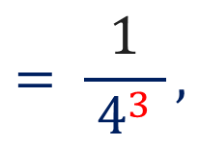


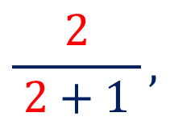
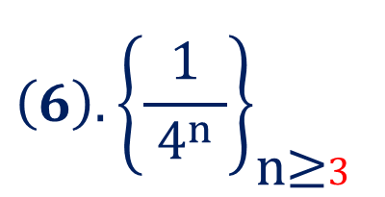

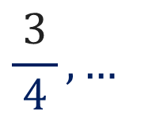
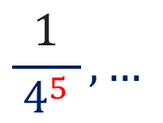

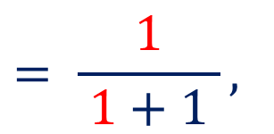

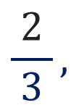
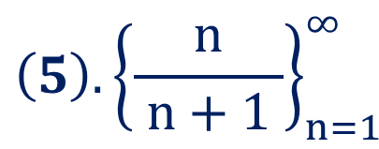
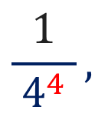


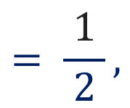
Sequence
Examples
$$\left(1\right). 2, 4, 6, 8, …$$
$$=\left\{2n\right\}$$
$$\left(3\right). 1, 2, 3, 4, …$$
$$={\left\{n\right\}}_{1}^{∞}$$
$$\left(2\right). 1, 3, 5, 7, …$$
$$=\left(2n−1\right)$$
$$\left(4\right). 2, 7, 12, 17, …$$
$$={\left\{5n−3\right\}}_{n≥1}$$
$$\left(5\right). {\left\{\frac{n}{ n+1 }\right\}}_{n=1}^{∞}$$
$$= \frac{1}{ 1+1 },$$
$$\frac{2}{ 2+1 },$$
$$\frac{3}{ 3+1 },…$$
$$= \frac{1}{ 2 },$$
$$\frac{2}{ 3 },$$
$$\frac{3}{ 4 },…$$
$$\left(6\right). {\left\{\frac{1}{ 4^{n} }\right\}}_{\text{n}\text{≥}3}^{}$$
$$= \frac{1}{ 4^{3} },$$
$$\frac{1}{ 4^{4} },$$
$$\frac{1}{ 4^{5} },…$$

Slide 6
Increasing and Decreasing Sequence

Slide 7








Sequence
Increasing Sequence
$$a_{n}−a_{n+1}≤0,∀ n∈ℕ$$
A sequence $\left\{a_{n}\right\}$ is said to be an increasing sequence if $a_{n}≤a_{n+1},∀ n∈ℕ\text{.}$
Examples
$$\left(1\right). 1, 3, 5, 7, …$$
$$a_{1}=1$$
Clearly,
$$a_{1}≤a_{2}≤a_{3}≤a_{4}…$$
$$a_{2}=3$$
Hence, given sequence is increasing.
$$a_{3}=5$$
$$a_{4}=7$$
$$⋮$$

Slide 8
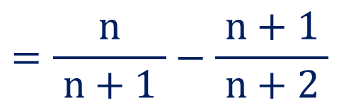

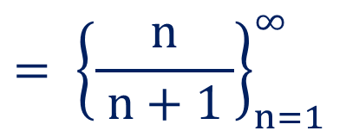


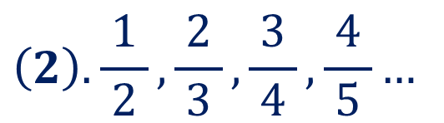
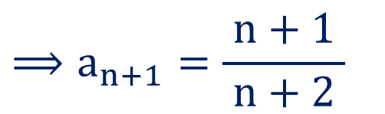
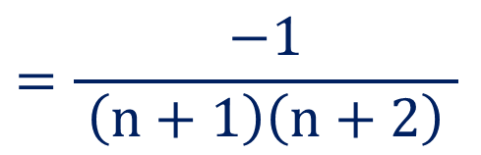
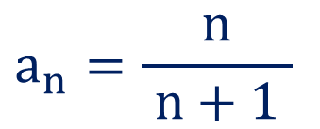

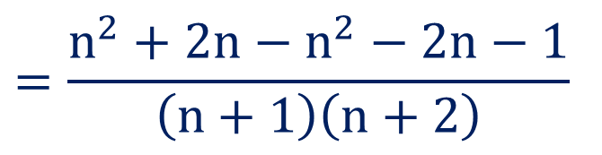

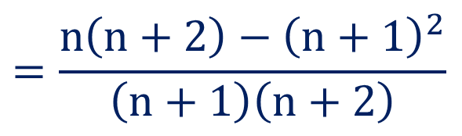

Sequence
$$a_{n}−a_{n+1}≤0,∀ n∈ℕ$$
$$\left(2\right). \frac{1}{ 2 },\frac{2}{ 3 },\frac{3}{ 4 },\frac{4}{ 5 }…$$
$$= {\left\{\frac{n}{ n+1 }\right\}}_{n=1}^{∞}$$
$$= {\left\{a_{n}\right\}}_{n=1}^{∞}$$
$$a_{n}=\frac{n}{ n+1 }$$
$$⟹a_{n+1}=\frac{n+1}{ n+2 }$$
Here,
$$=\frac{n^{2}+2n−n^{2}−2n−1}{ \left(n+1\right)\left(n+2\right) }$$
Now,
$$a_{n}−a_{n+1}$$
$$=\frac{−1}{ \left(n+1\right)\left(n+2\right) }$$
$$=\frac{n}{ n+1 }−\frac{n+1}{ n+2 }$$
$$≤0$$
as $n∈ℕ$
$$⟹a_{n}−a_{n+1}≤0, ∀ n∈ℕ\text{.}$$
$$=\frac{n\left(n+2\right)−{\left(n+1\right)}^{2}}{ \left(n+1\right)\left(n+2\right) }$$
Hence, given sequence is increasing.

Slide 9








Sequence
Decreasing Sequence
$$a_{n}−a_{n+1}≥0,∀n∈ℕ$$
A sequence $\left\{a_{n}\right\}$ is said to be a decreasing sequence if $a_{n}≥a_{n+1},∀ n∈ℕ\text{.}$
Examples
$$\left(1\right). −1, −3, −5, −7, …$$
Here,
$$a_{1}=−1$$
$$a_{2}=−3$$
Clearly,
$$a_{1}≥a_{2}≥a_{3}≥a_{4}…$$
$$a_{3}=−5$$
Hence, given sequence is decreasing.
$$a_{4}=−7$$
$$⋮$$

Slide 10
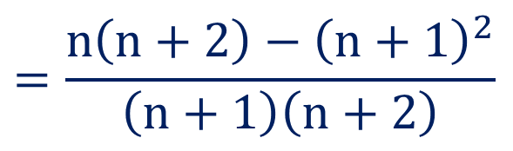
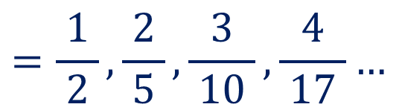

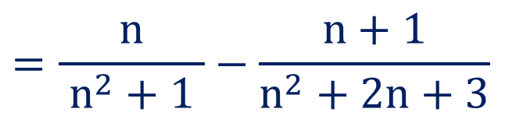

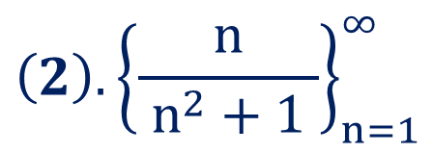



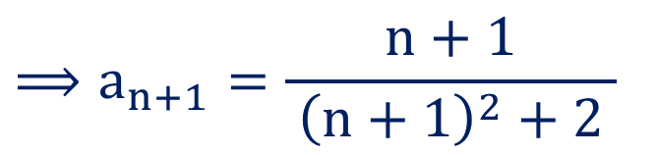

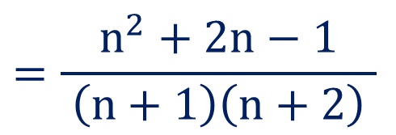
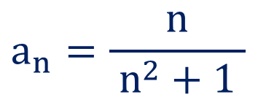
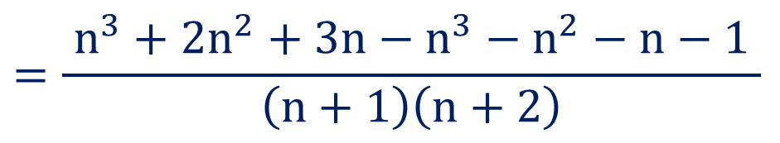
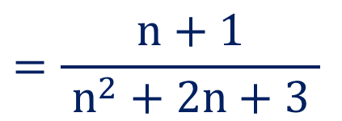
Sequence
$$a_{n}−a_{n+1}≥0,∀n∈ℕ$$
$$\left(2\right).{\left\{\frac{n}{ n^{2}+1 }\right\}}_{n=1}^{∞}$$
$$=\frac{1}{ 2 },\frac{2}{ 5 },\frac{3}{ 10 },\frac{4}{ 17 }…$$
$$= {\left\{a_{n}\right\}}_{n=1}^{∞}$$
$$a_{n}=\frac{n}{ n^{2}+1 }$$
$$⟹a_{n+1}=\frac{n+1}{ {\left(n+1\right)}^{2}+2 }$$
$$=\frac{n+1}{ n^{2}+2n+3 }$$
Here,
Now,
$$a_{n}−a_{n+1}$$
$$=\frac{ n^{3}+2n^{2}+3n−n^{3}−n^{2}−n−1 }{ \left(n+1\right)\left(n+2\right) }$$
$$=\frac{n}{ n^{2}+1 }−\frac{n+1}{n^{2}+2n+3}$$
$$=\frac{n^{2}+2n−1}{ \left(n+1\right)\left(n+2\right) }$$
$$≥0$$
as $n∈ℕ$
$$=\frac{n\left(n+2\right)−{\left(n+1\right)}^{2}}{ \left(n+1\right)\left(n+2\right) }$$
$$⟹a_{n}−a_{n+1}≥0, ∀ n∈ℕ\text{.}$$
Hence, given sequence is decreasing.

Slide 11
The Sandwich Theorem or Squeeze Theorem

Slide 12



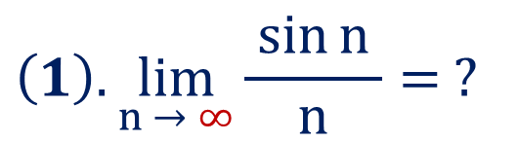

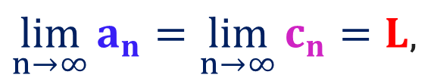
Sequence
The Sandwich Theorem OR Squeeze Theorem
Let $\left\{a_{n}\right\}, \left\{b_{n}\right\} \& \left\{c_{n}\right\}$ be the sequence of real numbers.
If $a_{n}≤b_{n}≤c_{n}, ∀n∈ℕ$ and
$\lim_{n→∞}{a_{n}=\lim_{n→∞}{c_{n}}}=L$,
then
$$\lim_{n→∞}{b_{n}=}L.$$
$$\left(1\right).\lim_{n → ∞}{\frac{\sin{n} }{n}}= ?$$
Examples
We know that
$$−1≤\sin{n}≤1, ∀ n∈ℕ$$
$$⟹−\frac{1}{ n }≤\frac{\sin{n }}{n}≤\frac{1}{ n }, ∀ n∈ℕ$$

Slide 13
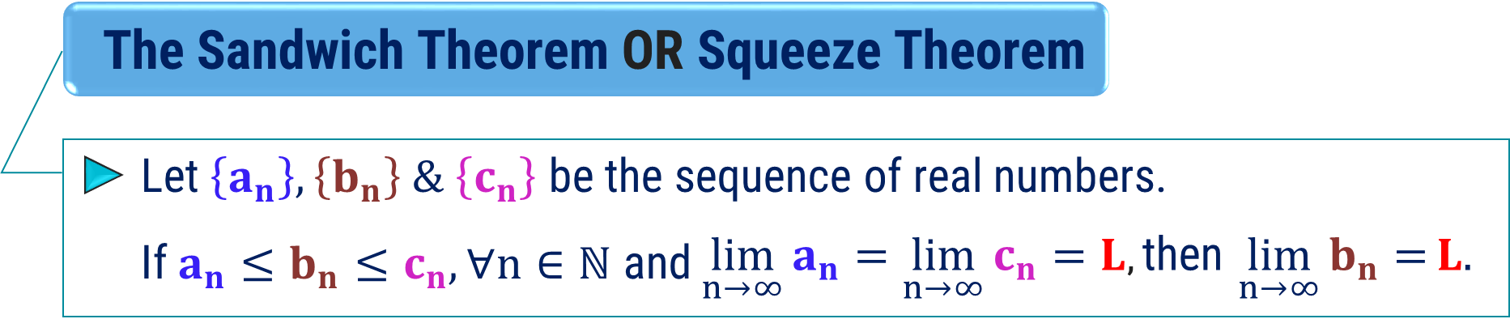

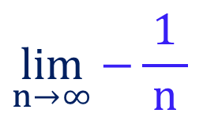


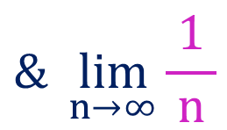


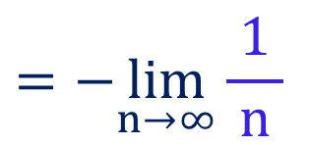
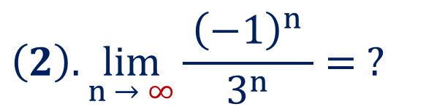
Sandwich Theorem
$$⟹−\frac{1}{ n }≤\frac{\sin{n }}{n}≤\frac{1}{ n }, ∀ n∈ℕ$$
$$\lim_{n→∞}{−\frac{1}{ n }}$$
$$=−\lim_{n→∞}{\frac{1}{ n }}$$
$$\& \lim_{n→∞}{\frac{1}{ n }}$$
Now,
$$={0}$$
$$={0}$$
$$\lim_{n → ∞}{\frac{\sin{n} }{n}}=0.$$
Hence, by sandwich theorem,
$$\left(2\right).\lim_{n → ∞}{\frac{ {\left(−1\right)}^{n} }{3^{n}}}= ?$$
We know that
$$−1≤{\left(−1\right)}^{n}≤1, ∀ n∈ℕ$$

Slide 14



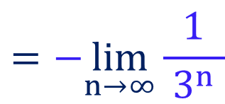

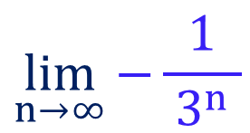

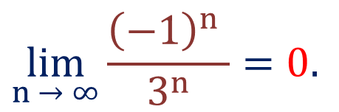
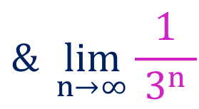
Sandwich Theorem
We know that
$$−1≤{\left(−1\right)}^{n}≤1, ∀ n∈ℕ$$
$$⟹−\frac{1}{ 3^{n} }≤\frac{ {\left(−1\right)}^{n} }{3^{n}}≤\frac{1}{ 3^{n} }, ∀ n∈ℕ$$
$$\lim_{n→∞}{−\frac{1}{ 3^{n} }}$$
$$=−\lim_{n→∞}{\frac{1}{ 3^{n} }}$$
$$\& \lim_{n→∞}{\frac{1}{ 3^{n} }}$$
Now,
$$={0}$$
$$={0}$$
$$\lim_{n → ∞}{\frac{{\left(−1\right)}^{n} }{3^{n}}}=0.$$
Hence, by sandwich theorem,

Slide 15
Convergent, Divergent and Oscillating Sequence

Slide 16


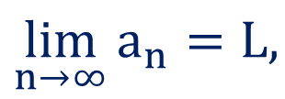
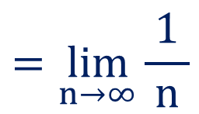

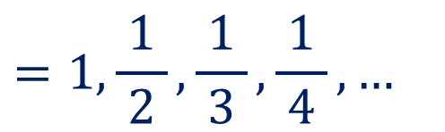









Sequence
Convergent Sequence
A sequence $\left\{a_{n}\right\}$ is said to be convergent if
$$\lim_{n→∞}{a_{n}=L,}$$
where $a_{n}$ is $n^{th}$ term of given sequence and ‘$L$’ is any finite number.
$$\left\{\frac{1}{ n }\right\}$$
$$=1,\frac{1}{ 2 },\frac{1}{ 3 },\frac{1}{ 4 }, …$$
Example
$$=\lim_{n→∞}{\frac{1}{ n }}$$
$$L=\lim_{n→∞}{a_{n}}$$
$$=0$$
$$0$$
$$\frac{1}{ 5 }$$
$$\frac{1}{ 4 }$$
$$\frac{1}{ 3 }$$
$$\frac{1}{ 2 }$$
$$1$$
$$…$$
$⟹L$ is finite.
Hence, given sequence is convergent.

Slide 17


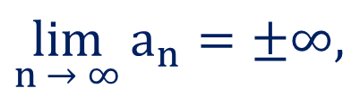










Sequence
Divergent Sequence
A sequence $\left\{a_{n}\right\}$ is said to be divergent if
$$\lim_{n → ∞}{a_{n}=±∞,}$$
where $a_{n}$ is $n^{th}$ term of given sequence.
Example
$$\left\{n^{2}\right\}$$
$$=1, 4, 9, 16, …$$
$$L=\lim_{n→∞}{a_{n}}$$
$$=\lim_{n→∞}{n^{2}}$$
$$=∞$$
$$1$$
$$4$$
$$9$$
$$16$$
$$…$$
$⟹L$ is infinite.
Hence, given sequence is divergent.

Slide 18












Sequence
Oscillating Sequence
A sequence which is neither convergent nor divergent is said to be an
oscillating sequence.
Example
$$\left(1\right). \left\{4−{\left(−1\right)}^{n}\right\}$$
$$=3, 5, 3, 5, 3, 5, …$$
$$L=\lim_{n→∞}{a_{n}}$$
$$=\lim_{n→∞}\left\{4−{\left(−1\right)}^{n}\right\}$$
Hence, given sequence is
Finitely oscillate between
$$=\left\{\begin{aligned} \\ \\ \end{aligned}\right.$$
$$4−1$$
$$=3,$$
if $n$ is even
$3 \& 5.$
$$4−\left(−1\right)$$
$$=5,$$
if $n$ is odd

Slide 19


Sequence
Oscillating Sequence
A sequence which is neither convergent nor divergent is said to be an
oscillating sequence.
Example
$$\left(2\right). \left\{{\left(−1\right)}^{n}n^{2}\right\}$$
$$=−1, 1,− 4, 4, −9, 9, …$$
The given sequence is neither diverges to $−∞$ and to $+∞.$
Therefore, the given sequence oscillate infinitely.

Slide 20







Method:2 Convergence of Sequence
$$\left(1\right).\left\{\frac{n^{2}+1}{2n^{2}−1}\right\}$$
Example:1
Check the convergence of
$$a_{n}=\frac{n^{2}+1}{ 2n^{2}−1 }$$
$$=\frac{ 1+0 }{2−0}$$
$$\left\{∵\lim_{n → ∞}{\frac{1}{ n }=0 }\right\}$$
Solution:
Here,
$$\lim_{n → ∞}{\frac{n^{2}+1}{ 2n^{2}−1 }}$$
$$=\frac{1}{ 2 }$$
Now,
Thus, the given sequence
$$=\lim_{n → ∞}{\frac{ n^{2}\left(1+\frac{1}{{ n}^{2} }\right) }{n^{2}\left(2−\frac{1}{ n^{2} }\right) }}$$
converges to 0.5

Slide 21







Method:2 Convergence of Sequence
Example:1
Check the convergence of
$$\left(2\right).\left\{4^{n+1}\right\}$$
Solution:
Here,
$$a_{n}=4^{n+1}$$
Now,
$$\lim_{n → ∞}{4^{n+1}}$$
$$=\lim_{n → ∞}{4^{n}∙4}$$
$$=4\lim_{n → ∞}{4^{n}}$$
$$=∞$$
Thus, the given sequence is diverges to $∞.$

Slide 22



Method:2 Convergence of Sequence
Example:2
Define the convergence of a sequence $\left(a_{n}\right)$ and verify whether the
$$a_{n}={\left(\frac{n+1}{ n−1 }\right)}^{n}$$
sequence whose $n^{th}$ term is
converges or not?
Solution:
Convergent Sequence
A sequence $\left\{a_{n}\right\}$ is said to be convergent if
$$\lim_{n→∞}{a_{n}=L,}$$
where $a_{n}$ is $n^{th}$ term of given sequence and ‘$L$’ is any finite number.

Slide 23




Method:2 $⇝$Example:2(Continue)
Example:2
Define the convergence of a sequence $\left(a_{n}\right)$ and verify whether the
$$a_{n}={\left(\frac{n+1}{ n−1 }\right)}^{n}$$
sequence whose $n^{th}$ term is
converges or not?
$$a_{n}={\left(\frac{n+1}{ n−1 }\right)}^{n}$$
$$=\lim_{n → ∞}{\frac{n^{n}{\left(1+\frac{1}{n}\right)}^{n}}{ n^{n}{\left(1−\frac{1}{n}\right)}^{n} }}$$
Solution:
Here,
$$\lim_{n → ∞}{{\left(\frac{n+1}{ n−1 }\right)}^{n}}$$
$$=\lim_{n → ∞}{\frac{{\left(1+\frac{1}{n}\right)}^{n}}{ {\left(1−\frac{1}{n}\right)}^{n} }}$$
Now,

Slide 24








Method:2 $⇝$Example:2(Continue)
$$=\lim_{n → ∞}{\frac{{\left(1+\frac{1}{n}\right)}^{n}}{ {\left(1−\frac{1}{n}\right)}^{n} }}$$
$$e^{1}$$
$$=\frac{ }{ }$$
$${ e}^{−1}$$
$$=e^{2}$$
$$=\frac{{\lim_{n → ∞}\left(1+\frac{1}{n}\right)}^{n}}{ \lim_{n → ∞}{\left(1−\frac{1}{n}\right)}^{n} }$$
$${\lim_{n → ∞}\left(1+\frac{x}{n}\right)}^{n}=e^{x}$$
We know that,
$${\&\lim_{n → ∞}\left(1−\frac{x}{n}\right)}^{n}=e^{−x}$$

Slide 25
Mathematics-I
GTU#(3110014)
Thank
You
Prof. Dhvanik H. Zala
Humanities & Science
dhvanik.zala@darshan.ac.in
8238588865

